Slide 1
Programming 1 - WEEK 2
Booleans
Conditionals
None

Slide 2


Slide 3
Recap - Introduction
Study Time – Schedule
Evaluation
GenAI
Class Rules
Setup & workflow
VS Code, Git, Python
Pytest
Missed it?
Check Toledo!

Slide 4

Recap - Arithmetic
Functions
Identifiers
Operators
Numbers
Rounding, min/max
Local variables

Slide 5

Permanent Evaluation
Be quiet - no talking
Don't cheat
Look at your own screen
ONLY allowed to be on ANS
No GenAI – No VSCode – ...
No ppt – No notes – ...
Browser full screen
Display Light 100%
Guess correction: -0.5 / +1
Close your laptop when finished

Slide 6
Programming 1 - WEEK 2
Booleans
Conditionals
None

Slide 7
Booleans
True (1) and False (0)
Comparisons:
== equal to
!= not equal to
< less than
<= less than or equal to
> greater than
>= greater than or equal to

Slide 8
Booleans - quiz
1*4 == 2*2
2 != 5/2
2 == 4%2
type(7/3) != type(1)
type(7/3) == type(9/3)
2/2 == True
True == ( 2 != 5//2 )
4.0 == 2*2 == True
TIP: test in pyshell

Slide 9

Booleans
Operators: and
or
not
x = 3
x == 3
→ True and False → False
→ True or False → True
→ not False → True

Slide 10
Programming 1 - WEEK 2
Booleans
Conditionals
None

Slide 11
Conditionals
if condition:
do A
and do B
…
more instructions (C)
A
B
True
condition
C
False

Slide 12
Conditionals
if condition:
do A
and do B
…
else:
do D
…
more instructions (C)
A
B
True
condition
C
False
D

Slide 13
Conditionals
if condition 1:
do A and B
elif condition 2:
do D
elif condition 3:
do E, F, G
else:
do H
do C
Condition 1
A
B
True
False
D
Condition 2
True
C
E
F
G
False
Condition 3
True
H

Slide 14

Conditionals
A book costs €24.95 for a private individual in the store, but bookstores get a 40% discount when purchasing. Additionally, there is an extra cost for shipping the books. It costs €3 for the first book, and €0.75 for each additional book. The discount does not apply to shipping costs.
Write a function orderBooks(x) for a bookstore where x is a positive integer representing the number of books to order. The function should return the total price for the order in euros, as a floating-point number rounded up to one decimal.

Slide 15
Programming 1 - WEEK 2
Booleans
Conditionals
None
Notes:
Dan zijn we er bijna. We moeten enkel nog None behandelen vandaag.

Slide 16
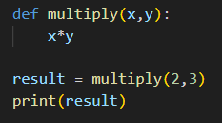

None
None is meant to represent a missing value
→ empty
→ non-existing
0 is a value !
None is not the same as zero !

Slide 17

Questions?

Slide 18
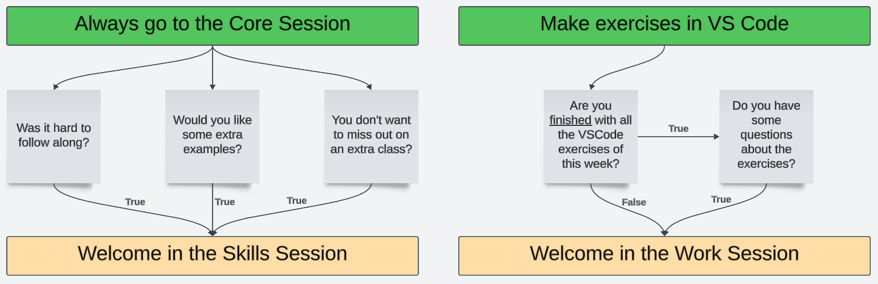
Core, Skills, Work?

